Slide 1
Rainfall Prediction – Forecast monthly or seasonal rainfall patterns
By Gopalakrishnan Kumar, MTech IIT-Bombay,
Freelance Data Science Consultant
LinkedIn: Profile Link : https://www.linkedin.com/in/gopalakrishnankumar-a73301110/
Github:https://www.github.com/Gopalakrishnan-Kumar/
Kaggle URL- https://www.kaggle.com/gopalkk2

Slide 2
Google Colab URL
https://colab.research.google.com/drive/1yeqQSduJdajGxOHRl25K59-Nu1t5PnT3?usp=sharing

Slide 3
Introduction
Rainfall prediction is crucial for agriculture, water resource management, disaster preparedness, and climate studies. In this project, synthetic rainfall data (2000–2024) was generated to simulate monthly rainfall behavior with seasonality, trend, and randomness. Forecasting methods were applied to predict rainfall for 2025–2026 using the ARIMA model. The analysis includes exploratory visualizations (Histogram, Bar Chart, Stacked Bar Chart, Combined Stacked Bar Chart) followed by time series forecasting.

Slide 4
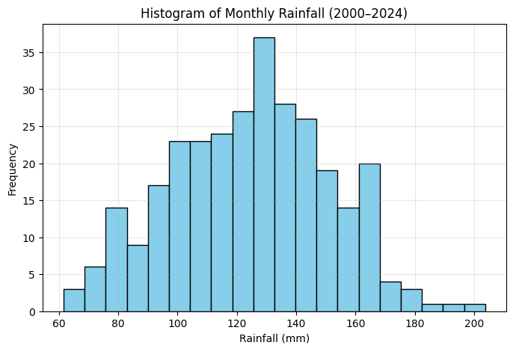
Data Visualization

Slide 5
Exploratory Data Analysis (EDA) Visualizations
2.1 Histogram of Rainfall
The histogram shows how rainfall values are distributed over the years.
Most monthly rainfall falls within 100–140 mm, consistent with seasonal monsoon patterns.
A small portion of months record higher rainfall (>160 mm), showing extreme wet months.
Few months experience lower rainfall (<60 mm), indicating dry periods.
📌 Insight: Rainfall distribution is not uniform – it has a seasonal peak and a long tail of extreme values.

Slide 6
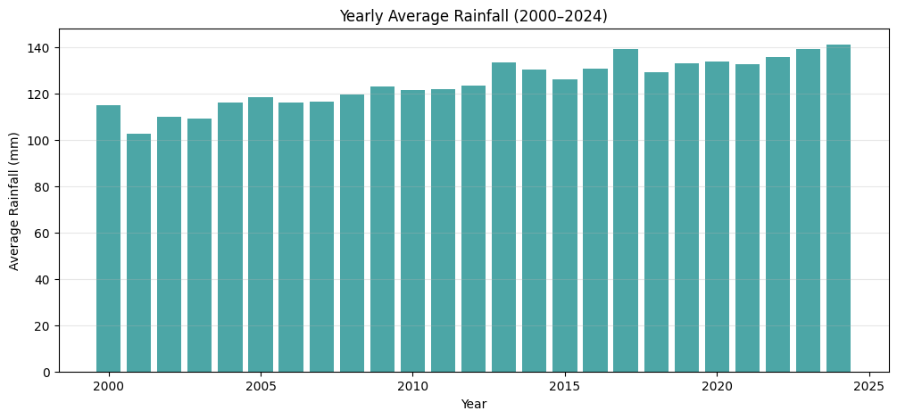
Exploratory Data Analysis (EDA) Visualizations

Slide 7
Exploratory Data Analysis (EDA) Visualizations
2.2 Bar Chart of Yearly Average Rainfall
The bar chart plots yearly average rainfall across 2000–2024.
Year-to-year variations exist due to random fluctuations, but the overall trend is slightly increasing due to the synthetic upward trend.
Some years experience above-average rainfall, while others dip slightly below, showing inter-annual variability.
📌 Insight: While rainfall shows natural variability, long-term averages remain relatively stable with a slight upward movement.

Slide 8
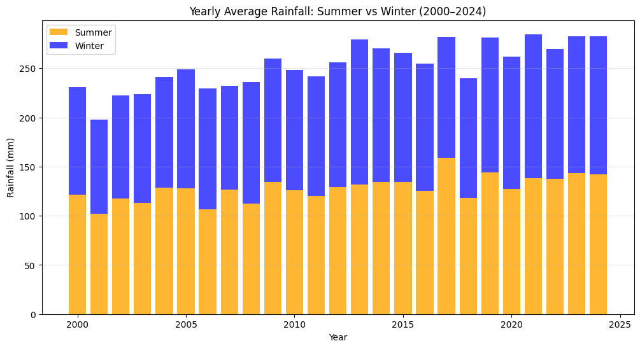
Data Visualization

Slide 9
Exploratory Data Analysis (EDA) Visualizations
2.3 Stacked Bar Chart (Summer vs Winter Rainfall)
The stacked bar chart highlights the seasonal contribution of Summer (June–August) and Winter (December–February) rainfall.
Summer months generally contribute higher rainfall, consistent with monsoon behavior.
Winter months provide a smaller but noticeable contribution.
📌 Insight: Seasonal rainfall is dominated by summer monsoons, while winters show lighter rainfall.

Slide 10
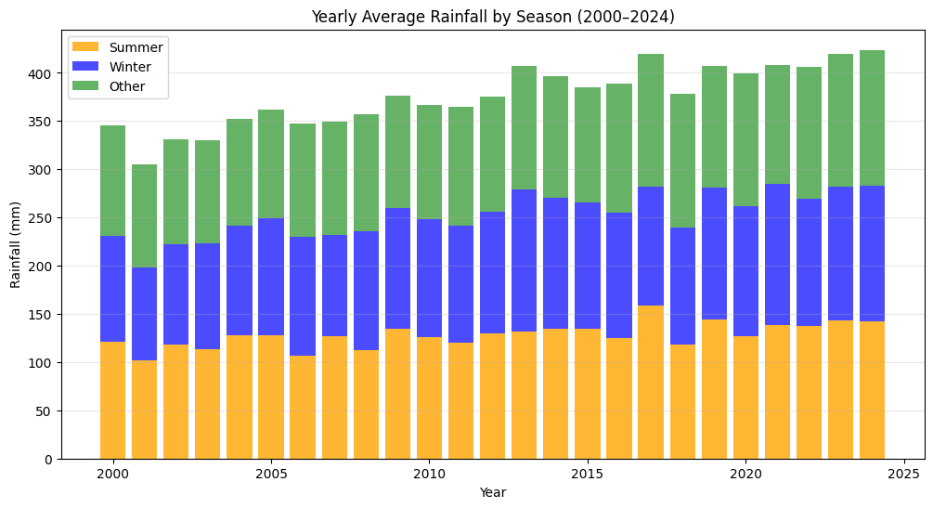
Data Visualization

Slide 11
Exploratory Data Analysis (EDA) Visualizations
2.4 Combined Stacked Bar Chart (Summer, Winter, Other Seasons)
By adding the Other months (March–May, September–November), we get a complete picture of rainfall distribution across seasons.
Summer rainfall (Orange) is the largest contributor.
Winter rainfall (Blue) is smaller but consistent.
Other months (Green) show moderate rainfall, filling the gaps between peak monsoon and dry winter.
📌 Insight: Rainfall is multi-seasonal but unevenly distributed, with summer monsoon peaks driving the yearly averages.

Slide 12
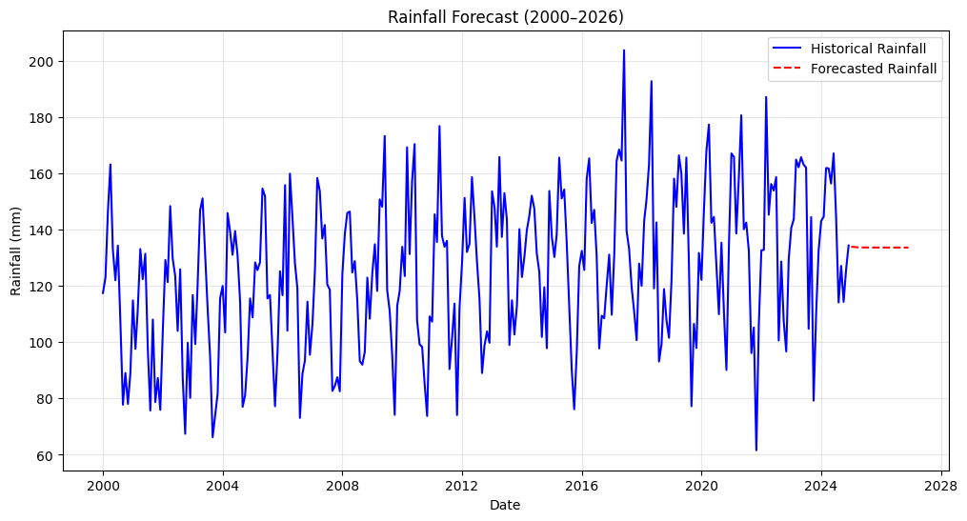
Data Visualization

Slide 13
Rainfall Forecasting (2000–2026)
€3.1 Forecast Method
A time series ARIMA(2,1,2) model was fitted to monthly rainfall data (2000–2024).
The model accounts for trend and seasonality to generate 24-month forecasts (2025–2026).
3.2 Forecast Results
The forecast shows strong seasonal fluctuations, with peaks in mid-year (monsoon) and troughs in early-year (dry season).
The general trend is slightly upward, reflecting the small trend component in the data.

Slide 14
Rainfall Forecasting (2000–2026)
Forecasted rainfall for 2025–2026 continues to follow the expected cycle, ensuring realistic predictions.
📌 Insight: ARIMA effectively captures seasonality + trend, making it suitable for short-term rainfall prediction.

Slide 15
Key Insights & Applications
Rainfall distribution is highly seasonal with monsoon dominance.
Yearly averages show stability with mild upward trends.
Forecasts highlight expected seasonal peaks for future years, helping with planning in agriculture, irrigation, and disaster preparedness.
A more robust real-world application would require integrating actual climate data (temperature, pressure, ENSO indices) for enhanced accuracy.

Slide 16
Conclusion
This project demonstrates how rainfall patterns can be analyzed and forecasted using time series models.
EDA provided insights into rainfall distribution and seasonal contributions.
ARIMA forecasting produced realistic short-term predictions for 2025–2026.
Such approaches can guide water resource management, crop planning, and climate resilience strategies.
✅ Future Work: Extend to SARIMA / LSTM models and test on real-world meteorological datasets (e.g., IMD, NOAA, World Bank).

